Slide 1
Project 1
Ergin Bostanci
Group 1

Slide 2
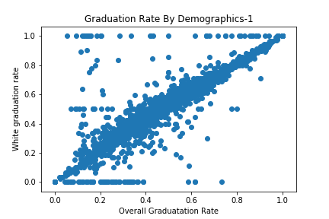
Graduation Rate Compared by Demographics
White – Overall

Slide 3
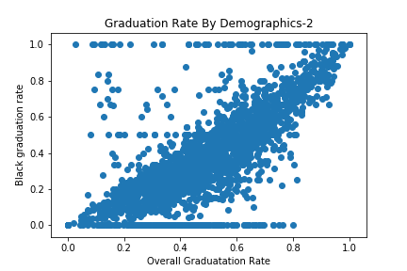
Graduation Rate Compared by Demographics
Black – Overall

Slide 4
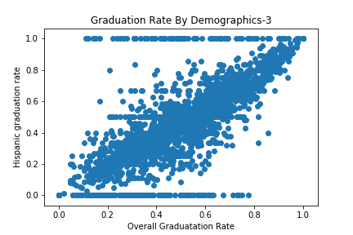
Graduation Rate Compared by Demographics
Hispanic – Overall

Slide 5
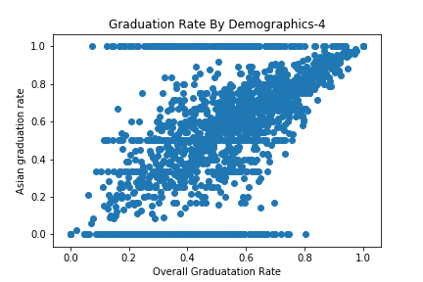
Graduation Rate Compared by Demographics
Asian – Overall

Slide 6
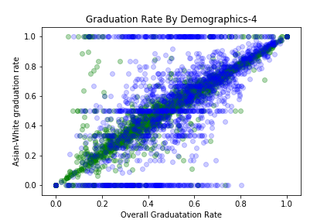
Graduation Rate Compared by Demographics
Asian is
White – Asian

Slide 7
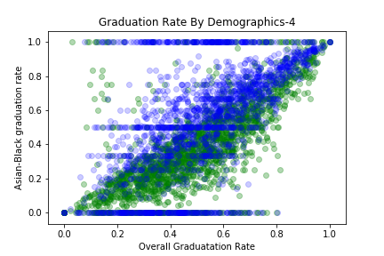
Graduation Rate Compared by Demographics
Asian is
Black – Asian

Slide 8
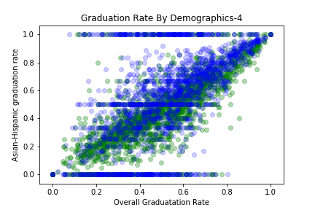
Graduation Rate Compared by Demographics
Asian is
Hispanic – Asian

